Slide 1
Capstone: TMC JigsaW Academy
DivyaTeja
Srisha
Ajay

Slide 2
Table of Contents
Executive Summary
Problem Statement
Our Approach
Tools used
Exploratory Data Analysis
Feature Selection
Model Selection
Modeling
Conclusions
Suggested Improvements
Appendix

Slide 3
Executive Summary
Price elasticity analysis allows firms to estimate the change in units sold for each change in the price of a product
This analysis is critical to firms in deciding how to price product, with direct implications on the total units sold, and the amount of profit earned
Our Client, The Math Company, a Bangalore based Data Science Consultancy, has tasked us with creating a price sensitivity model for an anonymous Women’s, work apparel, retailer in America

Slide 4
Problem Statement
Based on input from Jigsaw and our customer, and considering our constraints we elected to focus on determining price elasticity for the given data.
Price elasticity of demand (PED) is a measure used in economics to show the responsiveness, or elasticity, of the quantity demanded of a good or service to a change in its price when nothing but the price changes. More precisely, it gives the percentage change in quantity demanded in response to a one percent change in price.
We will aim to predict unit price, for a given product at a given quantity

Slide 5
Our Approach
With a short time horizon to complete our project, we opted for a simple and fast approach to get a handle on the data.
With a working understanding of the data, we would later be able to make more complex models with higher accuracy
We will be using linear regression models to predict our dependent variable: Unit Price
Exploratory Data Analysis
Feature Creation
Modeling
Understanding the data
Removing outliers and errors
Identifying variables with highest predictive ability
Run several models
Identify ideal approaches, and iterate to improve accuracy
Factorization and Grouping data

Slide 6




Tools used
Note: The data set we received caused significant memory issues for most team members. Memory issues continue to have a forcing effect on decisions and analysis options on the data
Microsoft Excel | Open Refine | Python
Used for loading of small data sets and quick data exploration | Data cleaning, and pattern identification for the main transaction data set | Primary tool for data cleaning, visualization, factorization and modelling

Slide 7




Exploratory Data Analysis: Data Sets
Product Dataset
Store Dataset
Transaction Dataset
The dataset contains 7 variables describing the details about the products .
Dataset contains 6 variables describing where the products are being sold .
Datasets contains nine variables regarding the Transactions done on a particular stock keeping unit(SKU)

Slide 8
EDA: Product Data
The data here is anonymized, resulting in complications in assessing the relation between several fields. For example the hierarchical relation between departments, class or subclass.
We notice that several fields are duplicates – for example class/class_name, department and department_name.
Detailed product profile data is attached in the appendix and profile HTML sheets.
Field | Unique Values | Assumed Meaning
DBSKU | 24292 | Individual Stock Keeping Unit
DEPARTMENT | 2 | Unknown, Hierarchy level 1
CLASS | 6 | Unknown, Hierarchy level 2
SUBCLASS | 15 | Unknown, Hierarchy level unclear (assumed lowest)
DEPARTMENT_NAME | 2 | Unknown, Hierarchy level 1
CLASS_NAME | 6 | Unknown, Hierarchy level 2
SUBCLASS_NAME | 8 | Unknown, Hierarchy level unclear

Slide 9
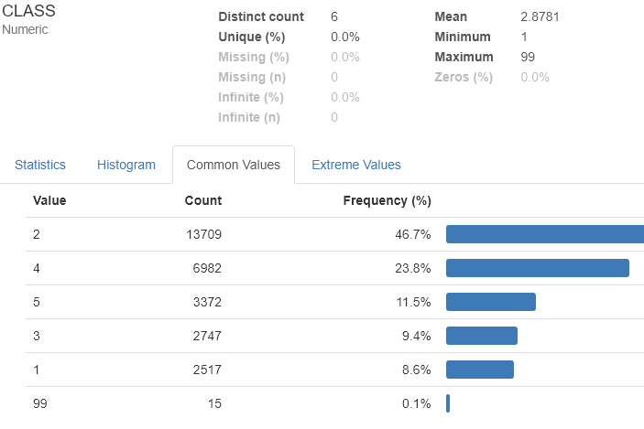
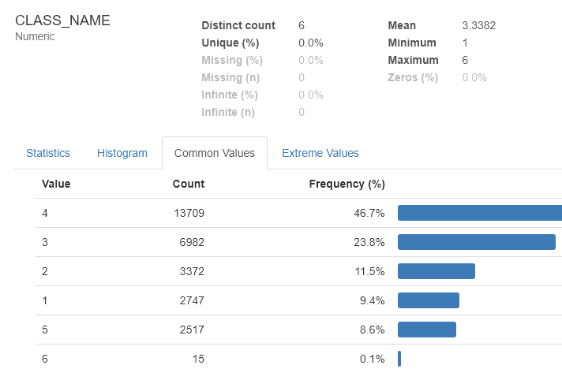
EDA: Product Data
Profile comparison of Class and Class_name
With identical distributions it is safe to assume that these are identical columns and can be dropped
Input from The Math Company indicates that class 99 is a test class and can also be dropped

Slide 10
EDA: Product Data Set, Key findings
Product Hierarch provided by TMC
BRAND
DEPARTMENT 1
DEPARTMENT 2
CLASS 1
CLASS 2
CLASS 1
CLASS 2
SUBCLASS 1
SUBCLASS 2
SUBCLASS 1
SUBCLASS 2
SUBCLASS 1
SUBCLASS 2
SUBCLASS 1
SUBCLASS 2

Slide 11
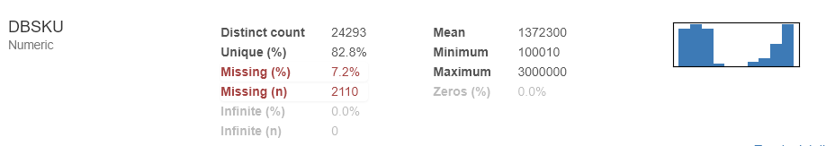
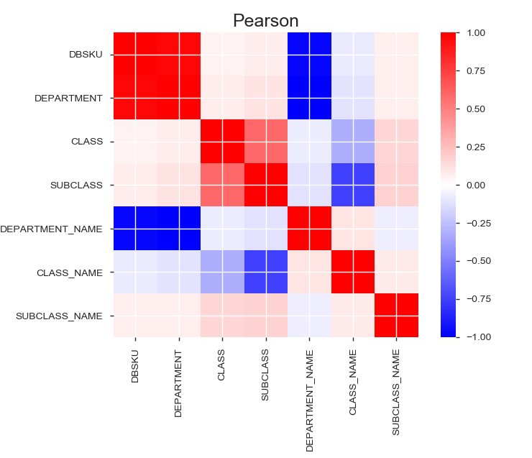
EDA: Product Data
DBSKU has missing data
We notice that there are spurious correlations in the data, in particular DBSKU has a bimodal distribution that correlates with department (values are 10,12) and can be ignored

Slide 12
EDA: Store Data
Data covers store locations over all states in America, along with store size and store type
Note: It is observed that 2 Loc Idnt represent stores used to indicate online transactions, for the final data set these stores have been separated into an online transaction data set
Detailed store profile data is attached in the appendix and profile HTML sheets.
Field | Unique Values | Assume Meaning
LOC_IDNT | 1303 | Store identifier
CITY | 926 | City
STATE | 50 | State
STORE_TYPE | 14 | Type of retail outlet
POSTAL_CD | 983 | Pin code
STORE_SIZE | 829 | Assumed Size of store in square feet?

Slide 13
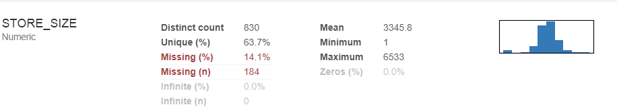
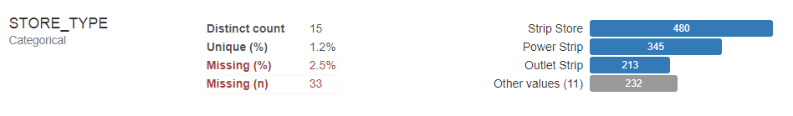
EDA: Store Data
Store size and Store Type have missing values .

Slide 14
EDA: Transaction Data
This data covers approximately 13 million transactions.
Detailed transaction profile data is attached in the appendix and profile HTML sheets.
Field | Assumed Meaning
DAY_DT | Date
LOC_INDT | Store Identifier
DBSKU | Stock Keeping unit
ONLINE_FLAG | (1,0) Assumed 1 is online, 0 is not,
FULL_PRICE_IND | FP/NFP, Assumed full price, NFP
TOTAL_SALES | Total selling price
TOTAL_UNITS | Total quantity sold
TOTAL_SALES_PRFT | Selling price - Cost price
TOTAL_COST | Cost price

Slide 15
EDA: Transaction Data
Critically we have observed that this data has several anomalies, which were excluded
There are several transactions with negative profit
Transactions with negative sales price and 0 sales price exist
Transactions with negative cost occur
Fractional quantities sold
Quantities less than 1 sold

Slide 16
EDA: Transaction Data
While these anomalies can be excluded, however there are transactions which are not obvious anomalies, and without customer input we cannot definitively exclude them
Transaction where the cost price is extremely low
Unit sales price is less than 2 and greater than 1
Full price/not full price - certain transactions were below cost price, but the full price flag was set
SKUs which have only a single transaction in their name
In addition, we have elected to treat online transactions as a separate data set and have removed it from the initial analysis

Slide 17
Feature Engineering: Overview
To reduce the noise and complexity inherent in the data we had to make several choices to enable the creation of an initial working model.
In particular:
Data was agglomerated at a state level, instead of city or pincode
The impact of cyclical data was reduced by bringing it into a seasonal format.
We analyzed products at a department and subcategory level instead of a SKU level

Slide 18
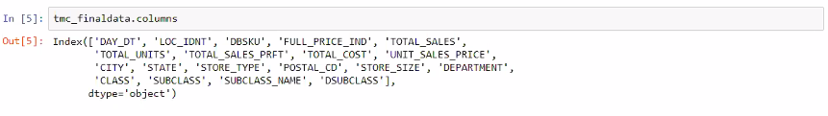
Feature Engineering: Column Pruning
The final Merged dataset contains the below features
Dropping the insignificant Variables:
'DEPARTMENT', 'SUBCLASS' are replaced with its equivalent "DSUBCLASS"
'CITY','LOC_IDNT', 'POSTAL_CD’ – Initial model is at State level, making these redundant
'TOTAL_SALES_PRFT', 'TOTAL_COST', 'TOTAL_SALES' are replaced with a Derived Column 'UNIT_SALES_PRICE'

Slide 19
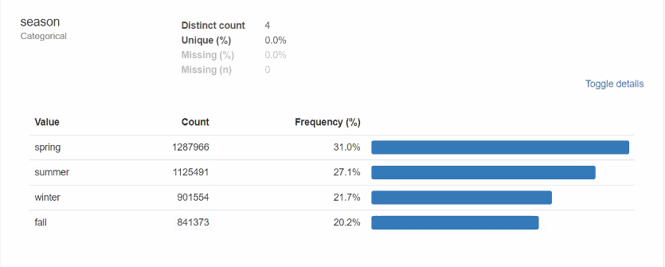
Feature Engineering: Date transformation
Transformed the Day_Dt column to Seasonal representation to analyze sales at Seasonal level

Slide 20
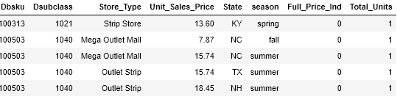
Feature Engineering: Grouping and Encoding
Post grouping, our data was reduced to 8 columns, with 5795032 rows of data
We proceeded to use one hot encoding to break up our categorical variables
and this expanded our data set 89 columns

Slide 21
Model Selection
Based on the literature on approaches to price sensitivity analysis, we selected variations of linear regression to model the relation between our dependent and independent variables.
The models we chose to run were:
Linear regression
Ridge regression
Lasso regression
Decision trees
Random forest

Slide 22
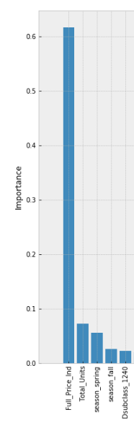
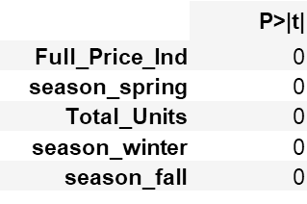
Modeling: Common Predictors
All models considered Full Price indicator, and seasonal variables as most important
Linear regression
P Values: Lower is better
Random Forest

Slide 23
Modeling
Initial Models on the dataset resulted in very low accuracy with R-Squared values of 24% for Linear , Ridge and Lasso Regression.
We surmised that accuracy was being impacted by outliers which were skewing data in the Total_Units column
Therefore, we have divided the grouped dataset into 3 parts and performed Modelling Separately
Transactions with Total_Units > 5 : 401528 transactions
Transactions with Total_Units > 10: 162872 transactions
Transactions with Total_Units > 20: 52916 transactions

Slide 24

Modeling: Total_Units > 5
OFFLINE
ONLINE
Linear Regression
R-Square
Ridge Regression
R-Square
Lasso Regression
R-Square
56.8%
56.6%
56.6%
Decision Tree
R-Square
58.7%
Linear Regression
R-Square
Ridge Regression
R-Square
Lasso Regression
R-Square
53.8%
53.8%
53.8%
Decision Tree
R-Square
54.1%
Used RidgeCV to get optimal alpha value = 0.005
Used LassoCV to get optimal alpha value = 0.000016,
0.000029
respectively
At Hyperparameters of Max Features = 29, 27 MaxDepth = 17, 15
repectively

Slide 25
Modeling: Total_Units > 10
OFFLINE
ONLINE
Linear Regression
R-Square
Ridge Regression
R-Square
Lasso Regression
R-Square
60%%
59.8%
59.8%
Decision Tree
R-Square
61.3%
Random Forest
R-Square
58.1%
Linear Regression
R-Square
Ridge Regression
R-Square
Lasso Regression
R-Square
53.8%
53.8%
53.8%
Decision Tree
R-Square
54.1%
Random Forest
R-Square
56.4%
Used RidgeCV to get optimal alpha value = 0.005
Used LassoCV to get optimal alpha value = 0.000024,
0.000043
respectively
At Hyperparameters of Max Features = 31, 25 MaxDepth = 13, 14
respectively

Slide 26
Modeling: Total_Units > 20
OFFLINE
Linear Regression
R-Square
61.8%
Decision Tree
R-Square
62.5%
Randomized Search
Random Forest
R-Square
85%

Slide 27
Conclusion
Our most accurate model, random forest with randomizedsearch provides a predictive accuracy of 85%.
However, considering the risk of overfit we consider the more conservative linear regression based models which have an accuracy of ~56% (linear, Ridge, lasso)
The models significantly weigh the following factors in predictions
Full price indicator
Total_Units
Season
Certain product categories
This suggests that the at the state level view of the data, nuance on location and product category provides weaker signal in comparison to time and discount information.

Slide 28
Suggested Improvements: EDA
This initial exploratory model suggests that a more detailed nuanced model will be able to provide predictive accuracy at very high level of granularity.
1) There is significant seasonal and cyclical information in the data which can be decomposed. This will create clearer price/quantity relations.
2) With a clustering algorithm, we could do market basket analysis and create superior clusters of products
3) There are many anomalies in the data, in particular with price information
Infrequent transactions, which result in a skew in the data
Products sold at inconsistent prices.
Dropping these anomalies in our data, resulted in an immediate gain in accuracy, however at the cost of broader predictive ability

Slide 29
Suggested Improvements: Feature Eng
Currently feature engineering via random forest, indicates many variables that intuitively should be significant, have little predictive value.
With more elaborate EDA, signal from these data points should be conserved leading to better feature engineering options.
In particular, it may be necessary to consider some form of binning to better organize the information present in the price column.

Slide 30
Appendix: Data Dictionary
Term |  | Definition
Tansaction DB
DAY_DT |  | Date
LOC_INDT |  | Store Identifier
DBSKU |  | Stock Keeping unit
ONLINE_FLAG |  | 1 is online, 0 is not,
FULL_PRICE_IND |  | FP - Full Price of the product. NFP - Non Full Price (i.e. some discount was applied to the tag pric
TOTAL_SALES |  | Total selling price
TOTAL_UNITS |  | Total quantity sold
TOTAL_SALES_PRFT |  | Selling price - Cost price
TOTAL_COST |  | Cost price
Product DB
DBSKU |  | PRODUCT ID
DEPARTMENT |  | PRODUCT DEPARTMENT ID
CLASS |  | PRODUCT CLASS ID
SUBCLASS |  | PRODUCT SUBCLASS ID
DEPARTMENT_NAME |  | PRODUCT DEPARTMENT NAME (1-to-1 mapping with Department ID)
CLASS_NAME |  | PRODUCT CLASS NAME (1-to1 mapping with Department ID x Class id)
SUBCLASS_NAME |  | PRODUCT SUBCLASS NAME (1-to1 mapping with Department ID x Class id x Subclass ID)
Store DB
LOC_IDNT |  | Store identifier
CITY |  | City
STATE |  | State
STORE_TYPE |  | Type of retail outlet
POSTAL_CD |  | Pin code
STORE_SIZE |  | Consider above 1000 as valid store sizes (there are junk values like 0 square feet)

Slide 31
Appendix: Additional Data
Data profiles have been created for the base data set, and can be found in:
product.html
Store.html
Transact.html
Data sets for cleaned data can be found in:
1)cleaned transaction profile.html
2) cleaned_product_profile.html
3) cleaned_store_profile.html
4) combined_dataset profile.html

Slide 32
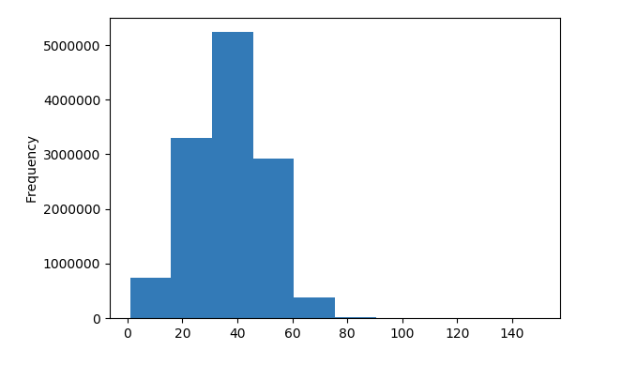
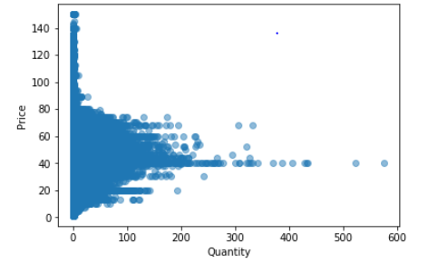
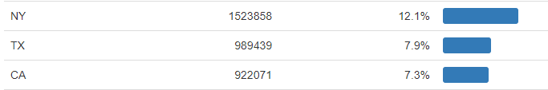
Sample EDA for transaction data set
Distribution of Unit_Sales_Price
Plot b/w Price and Quantity
Top 3 states with majority of Transactions

Slide 33
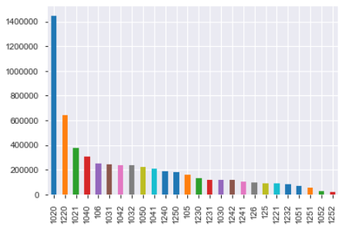
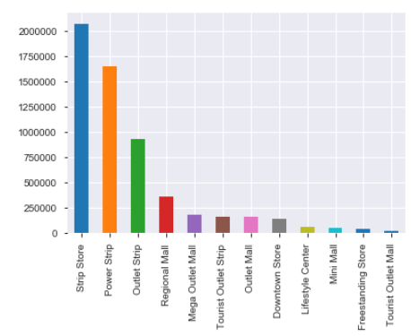
Sample EDA for transaction data set
Transaction Distribution across Dsubclass
Transaction Distribution across Store Types

Slide 34
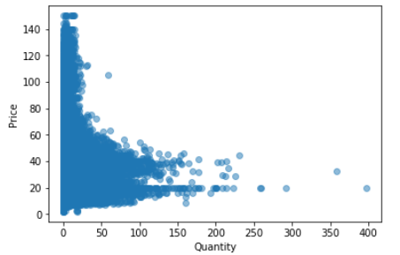
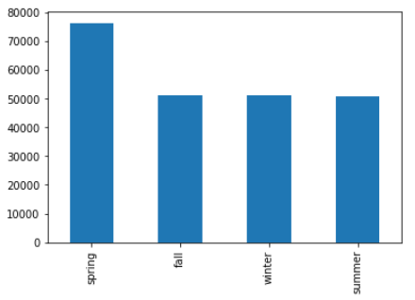
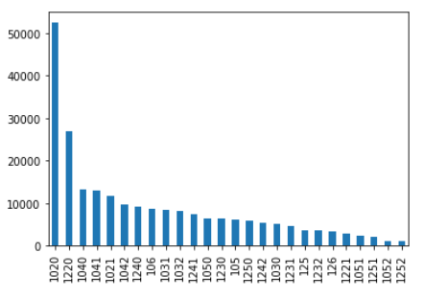
Sample EDA for transaction data set
Plot b/w Price and Quantity
Seasonal Sales
Transaction Distribution across Dsubclass

